Slide 1
JSP for Beginners
Amrita University

Slide 2
What is JSP?
Java Server Pages (JSP) is a technology which is used to develop web pages by inserting java code into the HTML pages by making special JSP tags.
The JSP tags which allow java code to be included into it are <% ----java code----%>.
It can be used as HTML page, which can be used in forms and registration pages with the dynamic content into it.
Dynamic content includes some fields like dropdown, checkboxes, etc. whose value will be fetched from the database.
This can also be used to access JavaBeans objects.
We can share information across pages using request and response objects.
JSP can be used for separation of the view layer with the business logic in the web application.

Slide 3
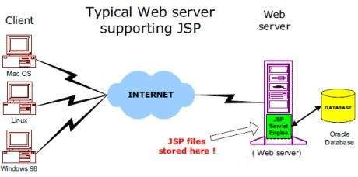
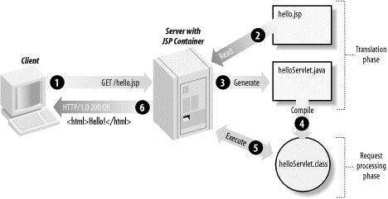
JSP - Architecture
The web server needs a JSP engine, i.e, a container to process JSP pages.
The JSP container is responsible for intercepting requests for JSP pages.
A JSP container works with the Web server to provide the runtime environment and other services a JSP needs.
It knows how to understand the special elements that are part of JSPs.

Slide 4
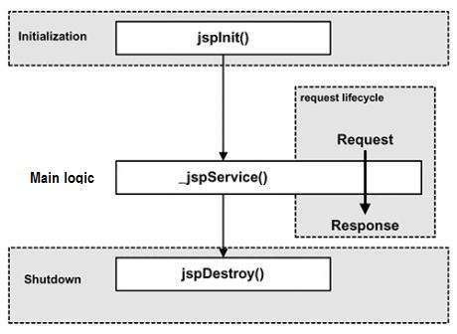
JSP - Lifecycle
JSP Compilation
When a browser asks for a JSP, the JSP engine first checks to see whether it needs to compile the page. If the page has never been compiled, or if the JSP has been modified since it was last compiled, the JSP engine compiles the page.
JSP Initialization
When a container loads a JSP it invokes the jspInit() method before servicing any requests. If you need to perform JSP-specific initialization, override the jspInit() method
JSP Execution
Whenever a browser requests a JSP and the page has been loaded and initialized, the JSP engine invokes the _jspService() method in the JSP.
JSP Cleanup
The destruction phase of the JSP life cycle represents when a JSP is being removed from use by a container.

Slide 5
Elements of JSP
The Scriptlet - A scriptlet can contain any number of JAVA language statements, variable or method declarations, or expressions that are valid in the page scripting language.
<html>
<head><title>Hello Scriptlet </title></head>
<body>
Hello Scriptlet !<br/>
<%
out.println("Your IP address is " + request.getRemoteAddr());
%>
</body>
</html>

Slide 6
Elements of JSP
JSP Comments
<%-- This is JSP comment --%>
<!-- comment -->
An HTML comment. Ignored by the browser.
JSP Directives
<%@ page ... %>
Defines page-dependent attributes, such as scripting language, error page, and buffering requirements <%@ include ... %>
Includes a file during the translation phase.
JSP Declarations
<%! int i = 0; %>
<%! int a, b, c; %>
<%! Sample s = new Sample(2.0); %>
JSP Expression
<%= expression %><p>Today's date: <%= (new java.util.Date()).toString()%></p>
JSP Actions
jsp:include
Includes a file at the time the page is requested.

Slide 7
How to add different fields inside the form tag
Netbeans IDE : Click the mouse inside form tag >> go to Tools>>Palette>>HTML/JSP Clips→ it opens palette manager.

Slide 8
How to add different fields inside the form tag
From the Palette manager first select form tag –it should be inside the body tag.
Don’t enter anything in that Action , just give the Name ( firstForm ) and click ok. The JSP page look as follows.

Slide 9
How to add different fields inside the form tag
Inside the form tag →

Slide 10
Click Submit Button → Go to the Thanks page
Step 1: Add new jsp by select the project >> right click >>new JSP—All the JSP should be inside the web pages folder.
Step 2: If user clicks submit button→ It should invoke the action . Go to first JSP , inside the form tag add action as new JSP ( eg . thanksJsp.jsp)
If you run the first JSP page , it opens up with the Submit button → if user clicks Submit button it goes to second JSP page ☺

Slide 11
Thanks

